Slide 2

FIRST REPORT
TOPIC: EMBEDDED SYSTEMS OBJECT-ORIENTED PROGRAMMING(OOP) IN C AND C++
Student : NGUYỄN TRẦN TIẾN DUY
ID : 20213848

Slide 3

TABLE OF CONTENTS
1. Introduction to OOP
2. Object-Oriented Firmware Programming
3. Implementing Inheritance in Embedded C and C++

Slide 4
1. INTRODUCTION TO OOP
a) What is OOP, UART?
Object-Oriented Programming (OOP): A programming paradigm based on the concept of “objects,” which can contain data and code.
Universal Asynchronous Receiver/Transmitter(UART): A hardware protocol for communication, transmitting data bit by bit, commonly used in microcontrollers.
Key Principles:
OOP
Polymorphism
Abstraction
Encapsulation
Inheritance
1/13

Slide 5
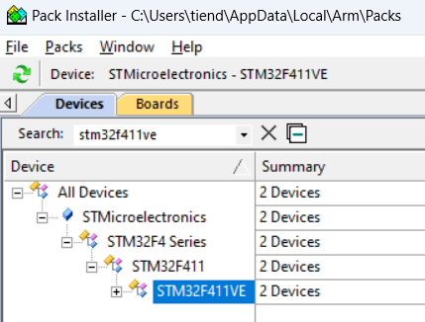

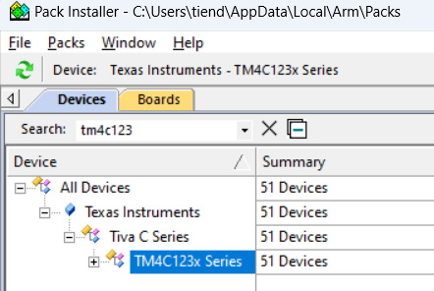
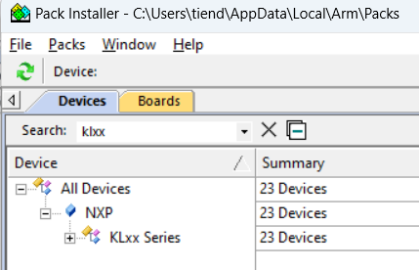
1. INTRODUCTION TO OOP
c) Download uVision and install packs
EX: STM32F411 microcontroller.
2/13

Slide 6
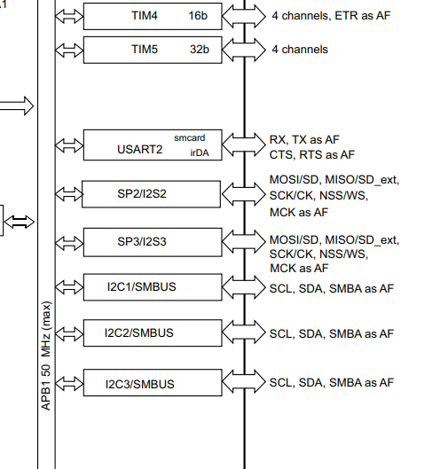
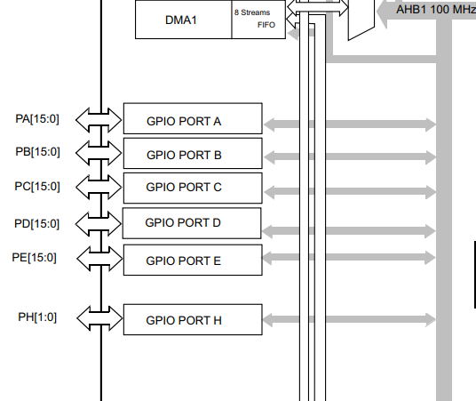
1. INTRODUCTION TO OOP
d) STM32F411VETx
GPIO pins are versatile digital signal pins on microcontrollers used for input or output tasks.
3/13

Slide 7
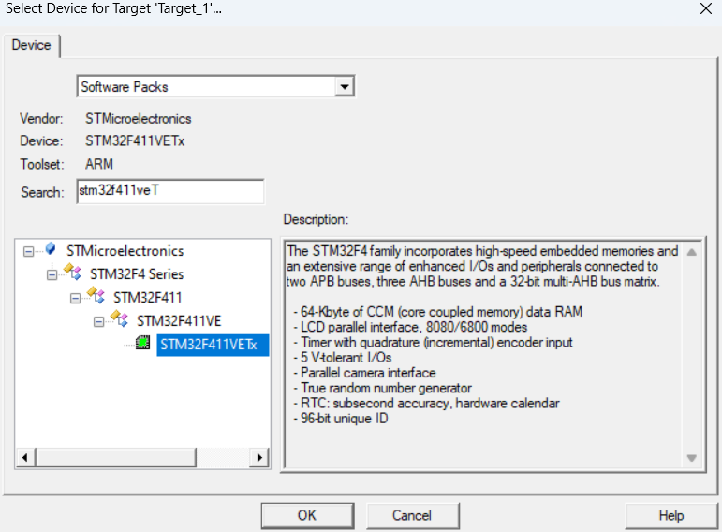
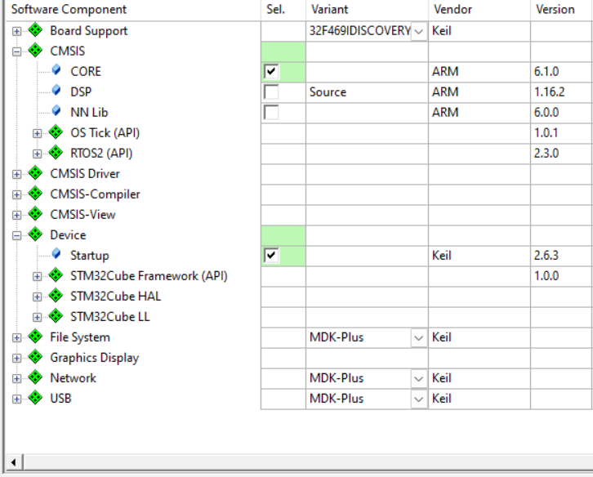
2. OBJECT-ORIENTED FIRMWARE PROGRAMMING
a) Key Steps for UART Setup: 1. Project Setup: Create a new project in Keil uVision.
1/6
4/13

Slide 8
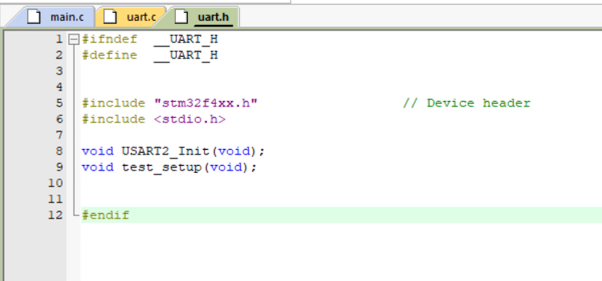
2. OBJECT-ORIENTED FIRMWARE PROGRAMMING
a) Key Steps for UART Setup: 2. File Creation: Create uart.h
5/13

Slide 9
2. OBJECT-ORIENTED FIRMWARE PROGRAMMING
b) uart.c
Function | Details
USART2_Init(void); | Enable clock for USART2 and GPIOA Configure PA2 and PA3 , set PA2 and PA3 to AF7 (USART2). Configure USART2 (baud rate, data bits, TX/RX) -> Enable USART2.
USART2_write(int ch); | Wait TX buffer to be empty -> Write character to data register -> Return character.
USART2_read(void); | Wait for character to be received -> Read character from data -> Return character.
*fgetc(FILE f); *fputc(int c, FILE f); | fgetc: Read character via USART2_read. If ‘\r’, echo and append ‘\n’, echo -> return character fputc: Transmit character via USART2_write().
test_setup() | Enter a number -> read number using scanf -> Display the number Enter a string -> Read string using gets -> Display the string.
6/13

Slide 10
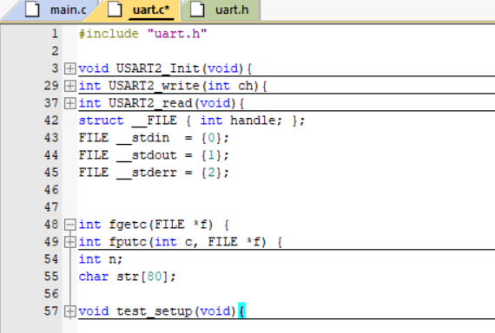
2. OBJECT-ORIENTED FIRMWARE PROGRAMMING
a) Key Steps for UART Setup: 2. File Creation: Create uart.c
7/13

Slide 11
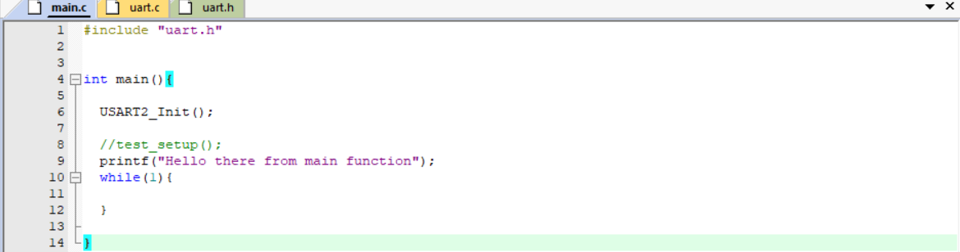
2. OBJECT-ORIENTED FIRMWARE PROGRAMMING
a) Key Steps for UART Setup: 2. File Creation: Create main.c
8/13

Slide 12
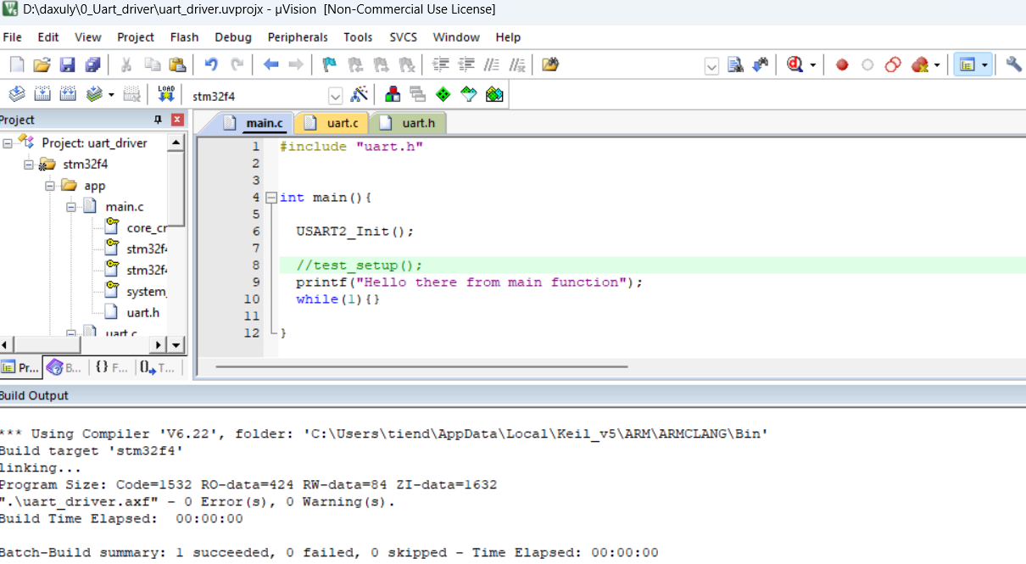
2. OBJECT-ORIENTED FIRMWARE PROGRAMMING
a) Key Steps for UART Setup:
9/13

Slide 13
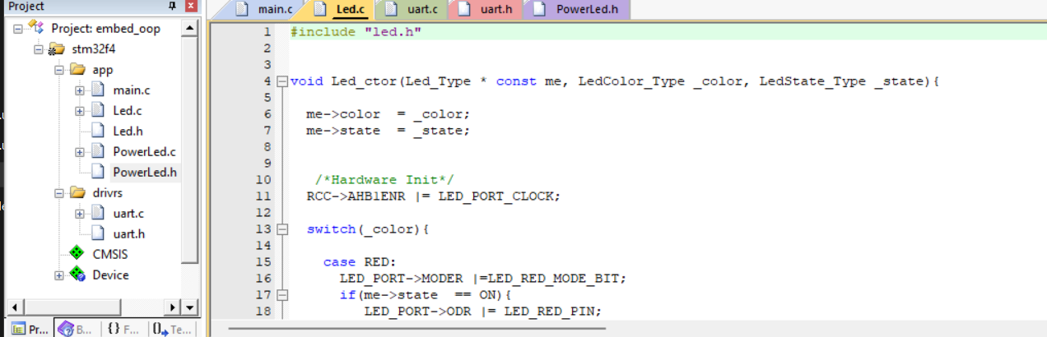
2. OBJECT-ORIENTED FIRMWARE PROGRAMMING
b) Key Steps for LED Setup: 1. Project Setup
- Using Uart Project to create LED project.
10/13

Slide 14
2. OBJECT-ORIENTED FIRMWARE PROGRAMMING
b) Key Steps for LED Setup: 1. Project Setup
Function | Details
Led_ctor() | Initializes hardware and sets the initial state (ON/OFF) Switches the LED pin based on the color and state
Led_setState() | Sets the LED state and modifies the corresponding hardware pin
Led_getState() | Returns the current state of the LED and prints the status.
Led_Type *const me | me inside the Led_ctor() will always point to led_ptr
RCC | Handles clock enablement for LED ports
LED_PORT | Used for setting the mode register and ODR (output data register) for LED control.
LED PIN | RED_LED_PIN, YELLOW_LED_PIN, BLUE_LED_PIN, GREEN_LED_PIN
11/13

Slide 15
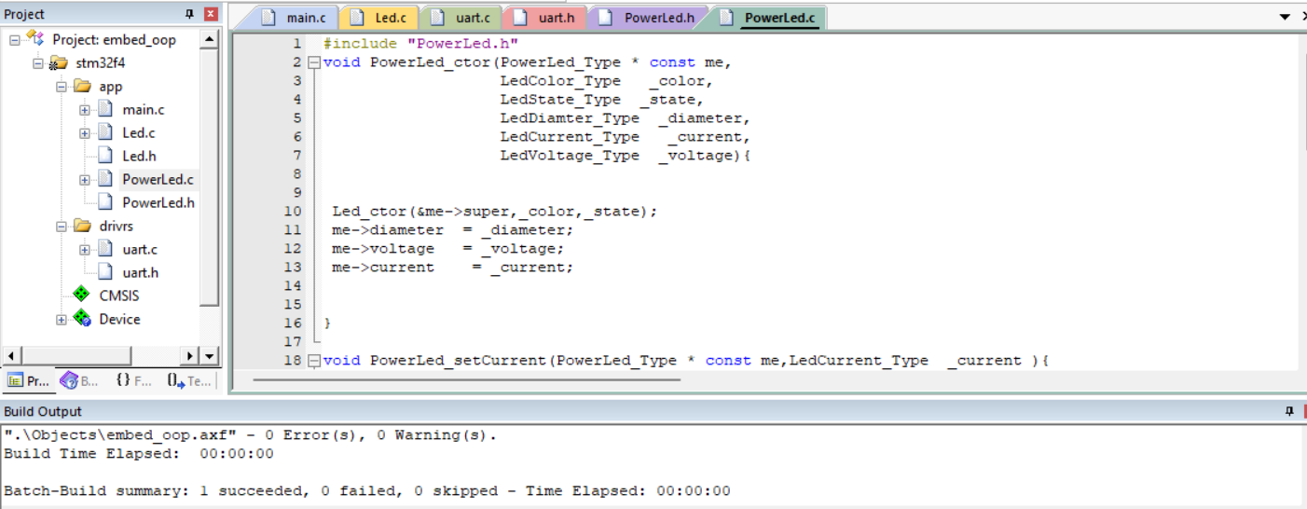
3. IMPLEMENTING INHERITANCE IN EMBEDDED C AND C++
a) Implementing Inheritance in LED using C: (1 led)
12/13

Slide 16
3. IMPLEMENTING INHERITANCE IN EMBEDDED C AND C++
a) Implementing Inheritance in LED using C:
Function | Details
PowerLed_ctor() | Initializes the PowerLed object and sets its attributes.
PowerLed_setCurrent() | Sets the current for the PowerLed.
PowerLed_setDiameter() | Sets the diameter for the PowerLed.
PowerLed_setVoltage() | Sets the voltage for the PowerLed.
PowerLed_computePower() | Computes and returns the power of the LED.
PowerLed_getCurrent() | Returns the current value of the PowerLed.
PowerLed_getDiameter() | Returns the diameter of the PowerLed.
PowerLed_getVoltage() | Returns the voltage value of the PowerLed.
13/13

